Slide 1
QANTLL 12: Out of this World!
Notes:
This online session introduced Guides to the Space create-a-challenge badge and got them started on some activities.

Slide 2
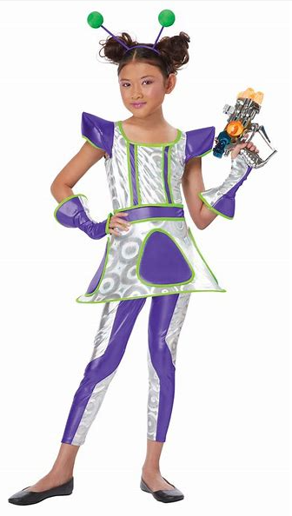
What did you dress as?
Notes:
Guides were asked to dress up. Get them to turn their webcams on and show how they dressed for session.

Slide 3
The Solar System
By Molli
Notes:
We had a senior Guide present some research she did about the Solar System – she sent in this PowerPoint before the session and then spoke to the presentation during the session.

Slide 4
Some Facts
The Solar System consists of the Sun, 8 main planets, dwarf planets, moons, asteroids, comets and human rubbish.
The Solar System was formed approximately 4.6 billion years ago.
Our Solar System is part of the Milky Way Galaxy.
The 8 planets are Mercury, Venus, Earth, Mars, Jupiter, Saturn, Uranus and Neptune in order from closest to the Sun to furthest away from the Sun.
Our Solar System was originally thought to be geocentric (everything orbits the Earth) with many additional loops to compensate for the odd patterns the Sun and planets appeared in the sky until Copernicus’ model helped to discover that our Solar System is actually Heliocentric (everything but the planets’ moons orbits the Sun) in the 16th Century.

Slide 5
The Planets
The four inner planets of the Solar System are Mercury, Venus, Earth and Mars.
These are known as terrestrial planets and are primarily composed of rock and metal.
The four outer planets of the Solar System are Jupiter, Saturn, Uranus and Neptune.
These are known as gas giants and are substantially larger than the other planets.
Jupiter and Saturn, the two inner gas giants, are the largest and mainly composed of hydrogen and helium.
Uranus and Neptune, the two outermost gas giants, are composed largely of ices and are sometimes referred to as the “ice giants”.

Slide 6
Dwarf Planets and Moons
There are many dwarf planets in our Solar System. They are Ceres, Pluto, Eris, Makemake and Haumea
Dwarf planets are round in shape, orbit the Sun just like the major planets but are not able to clear their orbital paths so there are no similar objects at roughly the same distance from the Sun. They are much smaller than a planet and even Earth’s moon but they aren’t moons.
Moons (aka natural satellites) orbit planets and asteroids. They come in many shapes, sizes and types.
There are many moons in our Solar System including Earth’s moon, Mars’ 2 moons, Jupiter’s 79, Saturn’s 53, Uranus’ 27, Neptune’s 14 and Pluto’s Charon!

Slide 7
Comets and Asteroids
Comets, Asteroids and the Meteors that come from them are leftovers from when the Solar System formed 4.6 billion years ago.
Although planets and moons have changed over this time, comets, meteors and asteroids have not – they are like a fossilised record of planetary evolution.
There are 795,074 known asteroids and 3,575 known comets.
Asteroids are made up of metals and rocky material, and comets are made up of ice, dust and rocky material.
Between Mars and Jupiter lies the Asteroid belt, home to most of the Solar System’s asteroids.

Slide 8
Human Rubbish / Space Junk
Human rubbish/debris (aka Space Junk) is all the unused satellites, parts of rockets and man-made objects remaining in space though they no longer serve any useful purpose.
Some of it floats free in space but most of it orbits the Earth.
It is estimated that there are hundreds of millions of pieces of space junk floating in our Solar System.
Some are as big as trucks and others are as small as a flake of paint.
They orbit the Earth at speeds up to 36,000km/h.

Slide 9
References
https://space-facts.com/solar-system/
https://en.wikipedia.org/wiki/Heliocentrism
https://www.jpl.nasa.gov/infographics/infographic.view.php?id=11268
https://solarsystem.nasa.gov/moons/overview/
https://spaceplace.nasa.gov/how-many-moons/en/
https://solarsystem.nasa.gov/asteroids-comets-and-meteors/overview/
http://coolcosmos.ipac.caltech.edu/ask/181-What-is-the-difference-between-an-asteroid-and-a-comet-
http://coolcosmos.ipac.caltech.edu/ask/185-What-is-the-asteroid-belt-
https://starchild.gsfc.nasa.gov/docs/StarChild/questions/question22.html

Slide 10
The Chat Challenge
What is an example of a natural satellite?
Moons are natural satellites as they orbit planets
What are asteroids made of?
Asteroids are made up of metals and rocky material
What year did man first land on the moon?
1969: Over 50 years ago!
Notes:
Each question is shown one at a time and Guides type in the chat box on Zoom the answers. The leader then shows the answer once everyone has had a go. You could also just get girls to call in their answers.

Slide 11
Time to Draw
Imagine that all humans have to move to Mars
Draw the house that you might live in
Draw an outfit you might wear
Remember, no part of your skin is allowed to touch the air on Mars
Notes:
Guides use pen and paper at home to tackle the challenge. They then use the webcam to share their drawings and we discuss what they drew.

Slide 12
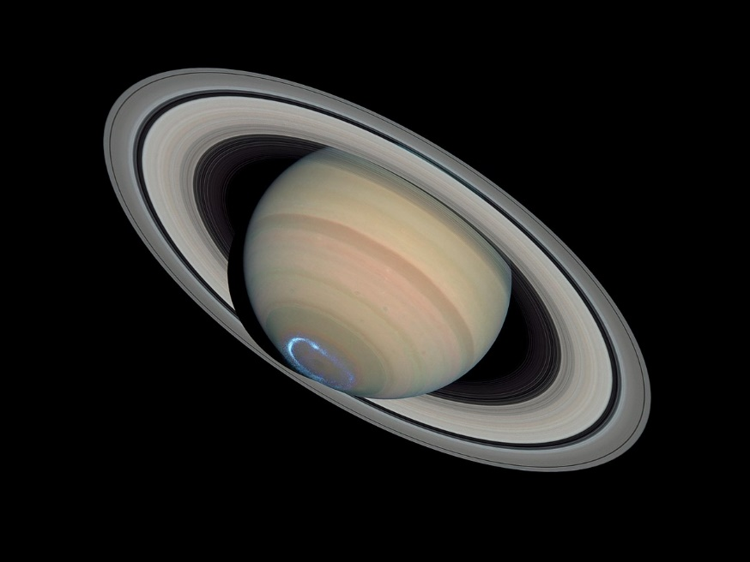
Learn the Order of the Planets
My - Mercury
Very - Venus
Energetic - Earth
Mother - Mars
Jumps - Jupiter
Straight - Saturn
Up - Uranus
Notes:
Guides practised learning the planet names – we had a discussion about Pluto as well. Guides could come up with their own ways of remembering all the planets.

Slide 13
Let’s Make Up a Story . . .
When it is your turn . . .
Add a sentence to the story to say what will happen next
Be creative
Keep the story going
Add another character or place
Notes:
Guides take turns to say a sentences. The leader may like to start to give an example: Once upon a time there was an astronaut who was keen to go to space. She had trained and trained and now she was finally in the rocket ready to go. Then the next Guide adds the next part of the story.

Slide 14
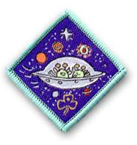
Want more? Outer Space Badge
Make a spaceship out of cardboard boxes
Do some star gazing
Visit an observatory
Use playdough to make models of the planets
Create a play about aliens visiting Earth
Try a rocket experiment
Notes:
We share ideas of what else Guides can do at home to earn the outer space badge. Guides are encouraged to send in photos and videos by email of what they have done.

